Slide 1
Instructional Expectations
2020/21 School Year

Slide 2
OUR WHY?
At Dutchess BOCES our primary commitment is to the students and families we serve. Our priority must be keeping them safe. When the 2020-2021 school year begins, on-campus school will look much different than previous years due to COVID-19 and the health and safety measures that continue to evolve. The Instructional Expectations will define clear guidance for the reopening of our classrooms and programs that aligns with the regulations developed in collaboration with NYSDOH and the NYS Education Department

Slide 3
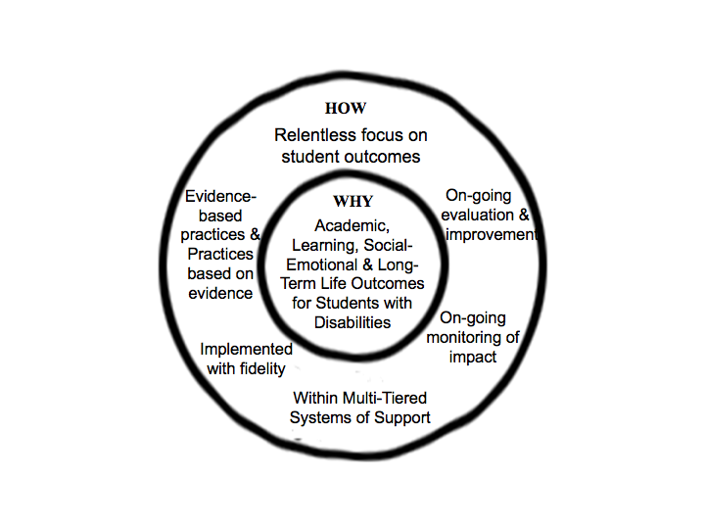
HOW
WHY
Academic Learning, Social Emotional well being and Long Term Life Outcomes for Students.

Slide 4
What we will cover…
Pedagogy (In-Person/Virtual Instructional Models, Daily Expectations, Staff Roles & Responsibilities)
Explicit Instruction (Lesson Planning, NYSED Instructional Mandates & Virtual Students)
Student Support (MTSS, Community Building, Accessibility, Management Needs, Related Services, Google Classroom/Voice, Technology & Professional Development)
Planning for the First Two Weeks with Students (Resources for Health and Safety, Social/Emotional Learning Strategies & Setting Up Physical/Virtual Space)

Slide 5
Pedagogy
(In-Person/Virtual Instructional Models, Daily Expectations, Staff Roles & Responsibilities)
Section I

Slide 6
In Person Instructional Focus
Power Standards
Prioritizing Face-to-Face time
Student Centered Thinking
Hands-On Activities
Community Building and Social Thinking Strategies

Slide 7
Daily Expectations
Flexible Pedagogy:
With flexible resilient pedagogy, you’ll create ONE set of activities that can work both face-to-face and online. It won’t matter if you’re teaching in your classroom or remotely next week, or if some of your kids are home and some with you in school, because you have a plan that works for any scenario. What I envision is creating structures and frameworks that can be reused over and over again, not only throughout this school year, but for many years to come because they are flexible and resilient to circumstantial change.
EP202-Resilient-Pedagogy
https://drive.google.com/file/d/1kktS4G1RHFHlPgqcanXUxpRGswUk4DTz/view?usp=sharing

Slide 8
Here are just a few examples of activities you probably know how to do in-person but can also be done virtually via free tools:
Exit tickets
Math manipulatives
Reading journals
Jigsaw
Choice boards/learning menus
The TQE method
Centers/station rotations
Retellings, reflections, and responses
Digital notebooks
Small group discussion
Reading books and real world texts
Kahoot group learning + review games
Think-pair-share (cyber sandwich) for discussing text/understandings (modified for K-2)
Links to Tools in this Document:
https://drive.google.com/file/d/1kktS4G1RHFHlPgqcanXUxpRGswUk4DTz/view?usp=sharing
With flexible resilient pedagogy, you’ll create ONE set of activities that can work both face-to-face and online. It won’t
matter if you’re teaching in your classroom or remotely next week, or if some of your kids are home and some with
you in school, because you have a plan that works for any scenario.

Slide 9
Staff Roles & Responsibilities
Virtual TAs
https://docs.google.com/document/d/1_D636RTCpwITSEEohj3epWGaxY2tB0jJjzDH9J155Hs/edit?usp=sharing

Slide 10
Hybrid Teaching Model
What is Hybrid Learning?
Although hybrid schools have been around for more than a decade, the concept is still relatively new and unknown to most.
Essentially, a hybrid school combines traditional in-person, brick-and-mortar education with online learning. The “hybrid” component refers to a physical environment that blends in-person and remote (at-home) learning. Every hybrid school approaches this combination differently. The amount of time students are spending in the building vs learning at home/online will vary from school to school, as will the nature and pacing of online resources.
The Hybrid Teacher Survival Guide
https://drive.google.com/file/d/1qWiiZl5lfPG97N1UgYbzaOjn31j4iseB/view?usp=sharing

Slide 11
Tips for Hybrid Teaching
Staying organized in how you post your work and communicate with your students is key to their academic success.
Cohesive and consistent systems among classes/colleagues help students navigate the online environment.
Students and parents have communication preferences. Ask them specifically how they’d like to communicate with you (text, email, Google Classroom) and they’ll be more likely to respond.
The amount of time available to complete a task is the amount of time it will take. If you give yourself all day to plan a lesson, it will take all day. If you give yourself an hour, it will take (just a little more than) an hour. Use timers to help you manage your time, and teach students to do the same.
Students are adaptable and resilient — don’t underestimate them.
YOU are adaptable and resilient — don’t underestimate yourself.

Slide 12
Synchronous/Asynchronous Instruction

Slide 14
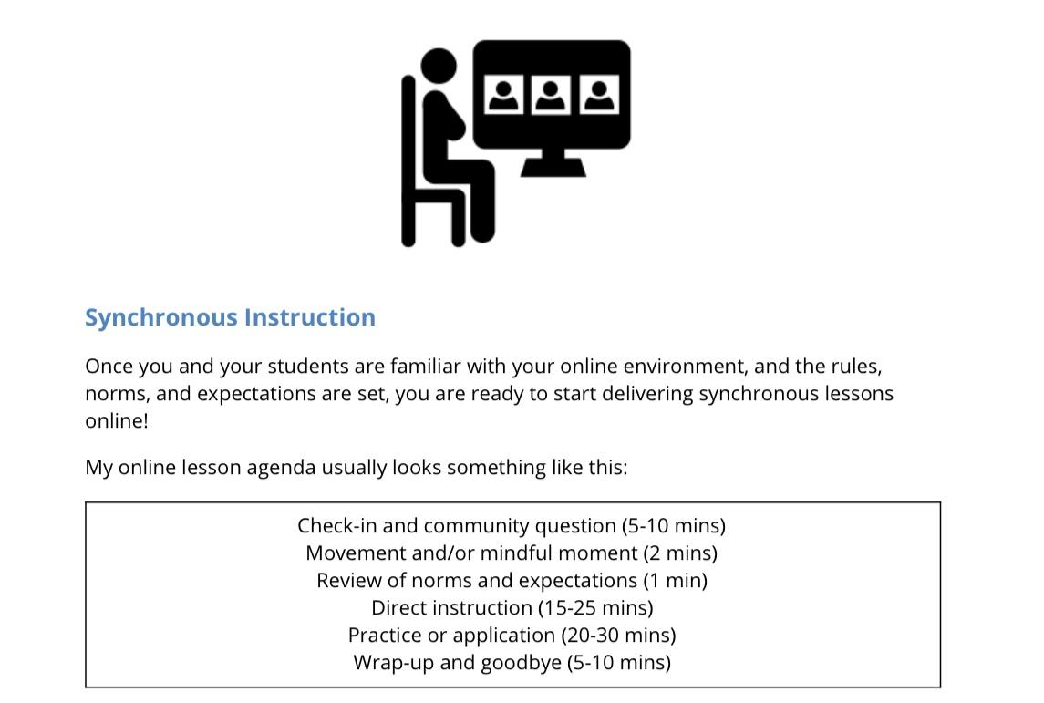
Synchronous Instruction Virtually
Sample Schedule

Slide 16
suggestions for creating a successful virtual learning environment

Slide 17
Setting Norms and Expectations in a Virtual Learning Environment
Teachers are accustomed to dedicating the start of every school year to establishing the norms and expectations of their class. Part of that process is introducing students to the physical classroom space and helping students understand how to navigate it.
A virtual classroom is no different. Start the year with a tour of the virtual environment, teach your students how to use the different functions of the video conferencing platform, and be sure to clearly establish your norms and expectations.

Slide 18
You must be present and actively engaged in the lesson
Being present and actively engaged means the students need to be in front of the screens for the entire lesson without physically wandering off to the bathroom or kitchen, or digitally wandering off to other games or tabs.
They also need to be actively engaged in the lesson. It is all too easy for a student to join the session, turn off their camera, and wander off to do other things.
Online, synchronous lessons require students to be actively responding to questions and participating in the instructional time.

Slide 19
2. Microphones must be muted unless told otherwise
While many video conferencing softwares have functionality that will allow you to mute or remove participants, clear expectations, strong relationships, and engaging lessons are the best possible behavior management strategies.

Slide 20
3. The chat box must be on-topic once the lesson starts
There are numerous ways in which the chat box can be used, students often prefer to use it as a social tool, always give students an opportunity to be social at the start of class, this helps build community.
At the start the lesson, verbally remind them of the norms and expectations, and tell them that from “this moment on” the chat box needs to be on topic.

Slide 21
DCBOCES Hybrid Instructional Schedule
 | Monday | Tuesday | Wednesday | Thursday | Friday
 | On Site | On Site | Some Specific Students On Site for Related Services All others Remote | Remote | Remote
 | Remote | Remote |  | On Site | On Site
COHORT A
COHORT B

Slide 22
Explicit Instruction
Sample Lesson Plan Template
https://docs.google.com/document/d/1k28AhKPRfVqEjWGAZdWMkoXUUgtp4nmrefAcWvT4nnM/edit?usp=sharing

Slide 23
Explicit Instruction
(Lesson Planning, NYSED Instructional Mandates & Schedules)
Section II

Slide 24
Explicit Instruction
https://drive.google.com/file/d/1_gR2jFsMNO5pt6LbVezGuwLHkLk2lnz6/view?usp=sharing
Dutchess BOCES Starts School Year Thursday
[PIC] Dutchess BOCES Employee Schedule Convocation Banner 2020
Dutchess BOCES Board of Trustees President Edward L. McCormick and District Superintendent Dr. Richard Hooley will welcome employees back beginning at 8:45 a.m. on Thursday, September 3.

Slide 25
Lesson Planning
DCBOCES expectation is that all planning should be recorded electronically. Although we are not requiring a single resource, here is an example of one that can be tailored and personalized to your needs, it can be downloaded right into your
Google Slides:
https://slidesmania.com/free-edu-digital-planner-made-with-google-slides-with-hyperlinks/

Slide 26
Schedules &
Instructional Requirements (NYSED)

Slide 27
Teaching and Learning Mandatory Requirements:
All schools must plan for in person, remote and hybrid models of instruction
Instructional decisions must be equitable and standards based and accessible to all students.
There needs to be routine, scheduled time for students to seek feedback from their teachers.
Instruction must be provided by an appropriately certified teacher with substantive interactions regardless of delivery.
Include how students needing additional social, emotional, and academic support will be supported
Allow ample time for students to re-adjust to the school setting.
Provide staff with opportunities to meet to discuss student needs.
Offer training and support for students and caregivers to ensure comfort and ease with technology.

Slide 28
Grades K-6
There are no subject specific time requirements for K-6.
Schools should employ the best available instructional practices and resources to maximize instructional time and support.
PE is important and students should be participating in physical activities under the supervision of a certified physical education teacher.

Slide 29
Grades 7-12/Units of Study
Grades 7-12 Mandatory Requirements:
Schools should consider the time requirement of 180 minutes of instruction as a benchmark.
Schools must decide if the instruction provided for the 2020-21 school year is comparable in rigor, scope, and magnitude to a traditionally delivered 180 min/week unit of study.
CTE social distancing practices for clinical hours
Work-based learning
Collaborate with businesses to identify work based opportunities (priority given to students who need work based hours for graduation requirements)
Definition of Unit of Study
At least 180 minutes of instruction per week.
Equivalent means at least 180 minutes of instructional time delivered face to face or through alternative experiences.
Must represent standards-based learning under supervision of an appropriately certified teacher.
Must include (but not limited to) meaningful and frequent interaction with a teacher, academic, and other supports, and instruction content that reflects an expectation as in-person instruction.

Slide 30
Virtual Students

Slide 31
Suggestions for Students Virtual Only
Literacy addressed everyday, whether explicit or embedded through direct or independent practice
Grades K-5
Synchronous: Morning Meetings and Check-Ins (3 times per week)
Asynchronous: Instruction should have, at most, two videos and a action item to provide feedback at their ability level
Instructional Focus
Monday/Tuesday: ELA & SS Focus
Wednesday: Community Building SEL
Thursday/Friday: Math & Science

Slide 32
Suggestions for Students Virtual Only
Grades 6-12/CTE Subject Areas
Synchronous: Check-Ins (3 times per week)
Asynchronous: Instruction should have, at most, three/four videos and a action item to provide feedback at their ability level in each subject area
Instructional Focus in Each Subject Area
Monday: Video & Activity
Tuesday: Discussion Opportunities
Wednesday: Community Building SEL
Thursday: Choice & Exploration
Friday: Submission

Slide 33
K-12 During the Day (Teachers & Teaching Assistants)
Checking email and Google Classroom Stream
Create/provide Instructional Videos specific to topic, subject area
(Carefully Cultivated Resources)
Provide Independent Practice (Ex. I-Ready, Project Based Learning, Rubrics)
Organize Content to make sense with clear direction
Lead live meetings and post your contact information and hours

Slide 34
Student Support
(MTSS, Community Building, Accessibility, Management Needs, Related Services, Google Classroom/Voice, Technology & Professional Development)
Section III

Slide 35
RTI/MTSS
Notes:
RTI: Response to Intervention/Multi-Tiered Systems of Support.

Slide 36
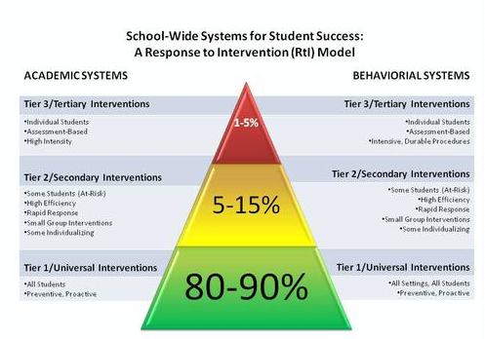
RTI Model

Slide 37
Building a Community “Virtually”
Learning Styles Inventory

Slide 38
Accessibility
Making Google Classroom Accessible

Slide 39
Student Management Needs
Student Management Needs/Accommodations/Modifications section on IEP must be reviewed and implemented accordingly during interim virtual instruction.
Teachers should keep in mind the challenges students and families face as they try to navigate online learning. Ex. ensuring appropriate breaks, time to stretch, etc. should be provided on a regular basis throughout the morning.
Remember the challenges some of our students have when in person? Those same difficulties may be exacerbated when trying to learn online.

Slide 40
Quick Movement Ideas (Google Search for More)
Would you rather...
Dance up a storm…
Freeze Dance…
5-4-3-2-1 In this simple game, students stand up and the teacher (or leader) has them do five different movements in descending order…
Break out in song…
Simon Says…
Stretching/Yoga
Pretend you are a (Lion, Horse, etc)...
Students should have breaks should be scheduled during all transitions, they can be quick

Slide 41
Teacher/Staff Responsibilities for Online Learning
Use of Google Classroom;
Post student expectations for online learning;
All Building Administrators, co-teachers (consultant teachers, academic integration teachers), and RSP (as appropriate based on students’ IEPs) must be added as co-teachers to your classroom;
Post lessons and activities weekly;
Teachers are required to provide students with live/synchronous learning for specific days and times.
Social/Emotional impact of online learning.
Online Teaching Expectations for Teacher/Staff
https://docs.google.com/document/d/1k6V1JS1f1dysUzWbEtEvhDBDWM0FZtG1sNno4Vw-6_I/edit?usp=sharing

Slide 42
Related Service Providers
RSP must use calendar & meet to schedule sessions with students through G suite (Use the menu icon, click either as the creator or student for access to the calendar OR meet icons) This way it will not be confused with classroom academic groups, and other services scheduled. Karyn Lange must be included on all of the RSP meets scheduled with students.
If any administrator or colleague joins your Meet after you've begun instruction please continue teaching, to prevent interrupting the dynamic. If you have multiple teachers or RSP in a meet at once, please review among yourselves prior to instruction how you will be operating to maximize student engagement and involvement throughout the instructional block.

Slide 43
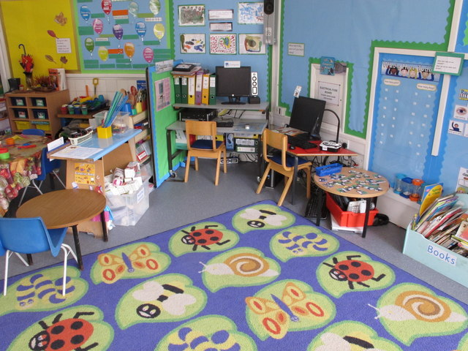
Google Classroom (Logistics)
https://docs.google.com/document/d/1NzJxj6B-win3FU_qLCysbHAStojwbfuXKUEQ1rtgXNY/edit?usp=sharing

Slide 44
Students Online Responsibilities
Students MUST be enrolled in their Google Classroom regardless of the method of activity completion (paper-based or digital). Students should be using their BOCES Ids to log-in.
It is expected that students will complete assignments during this online-learning experience to the best of their ability.
Students will be held accountable for work during this time.
Students should log in each day to view assignments, and complete them in a timely fashion.
Students (and/or parents) should contact the teacher via email or on the classroom stream with general questions or concerns regarding assignments. Any questions that are student specific should be asked through email, text message or phone call.
Teachers will remain available via email throughout the school day.
Students must demonstrate participation in order to be assessed on IEP Goals.

Slide 45
Resources
WE'RE HERE TO HELP!
We want to make the transition to online learning easier for educators and parents. Check out the BOCES link below for educator resources, tips and advice for online learning.
https://www.dcboces.org/node/1729
COVID RESOURCES
https://docs.google.com/document/d/17B1oWfbdvghr7VmgPA6xhX2-UsVLW17ebBAcqdbv7fQ/edit?usp=sharing

Slide 46
Technology
Most students already have tech needs met as per the survey information we have. If additional needs come up, we will address. Please communicate any needs to your immediate supervisor.

Slide 47
Google Voice
In order to maintain communication effectively with families teachers/RSP will be checking in with parent/guardian X times per week.
To do so effectively staff can/will? Use a Google Voice number
This will allow staff to maintain their personal phone number privacy, as well as forward appropriate communications to administration
Please follow the link to register with Google Voice
Good Voice Setup

Slide 48
Professional Development/Training
Google Classroom: Including effective online lesson design-synchronous/asynchronous
Explicit Direct Instruction
Providing Feedback
Screencastify - recording lessons
PBIS Online- Setting Expectations, Online Behaviors to Acknowledge, Digital Acknowledgements, CICO Support
Social-emotional supports online

Slide 49
Planning for the First Two Weeks with Students
(Resources for Health and Safety, Social/Emotional Learning Strategies & Setting Up Physical/Virtual Space)
Section IV

Slide 50
Planning for the First Two Weeks

Slide 51
Setting Up Your Classrooms (Physical and Virtual)
Digital First Week of School (Google Classroom):
https://docs.google.com/presentation/d/1tAd9LqcQbuiQC3kK0cJfJFj5_QzsAGnvAx8ZmbFaz1I/:edit?usp=sharing
Physical Space/On-Site Classroom:
What Does Good Classroom Design Look Like in the Age of Social Distancing?
https://www.edsurge.com/news/2020-06-22-what-does-good-classroom-design-look-like-in-the-age-of-social-distancing
Early Childhood/Elementary
https://mdek12.org/sites/default/files/social_distancing_strategies_in_the_classroom_7-13-2020_002.pdf
Station Rotation in an Era of Social Distancing
https://catlintucker.com/2020/06/station-rotation-in-an-era-of-social-distancing/

Slide 52
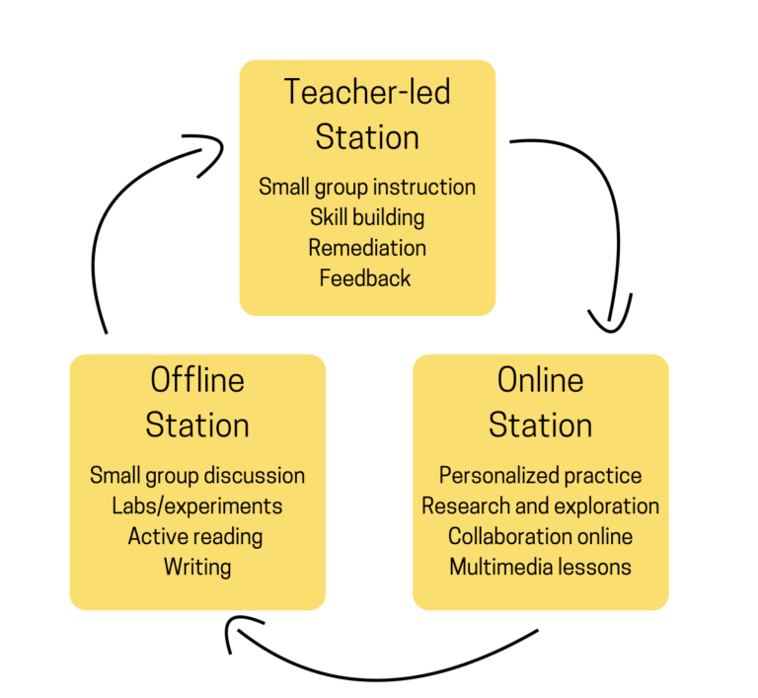
Station Rotation in an Era of Social Distancing
Physically
Virtually
[Template] Virtual Station Rotation Lesson
https://docs.google.com/document/d/1CxBd0gct0DoOrF-uWUm8p0fBJHBSl4jAfLIRdhty1HI/edit?usp=sharing

Slide 53
Health and Safety
*This will be School/Building Resource Specific

Slide 54
Social Emotional Learning
In planning for our re-entry in September, our work is grounded in our beliefs the most equitable opportunities for educational success relies upon the comprehensive support for students and families provided in our schools with our professionals and the systems of support we have built. These supports include academics as well as the social and emotional well-being of our students. We are committed to prioritizing social emotional well-being - not at the expense of academics, but in order to create the mental, social and emotional space to access rigorous academic content with confidence.
Social Emotional Teaching Resources
https://drive.google.com/file/d/1B2xsQpNvczosPv50_VO-QXOdM0AAW7GE/view?usp=sharing

