Slide 1
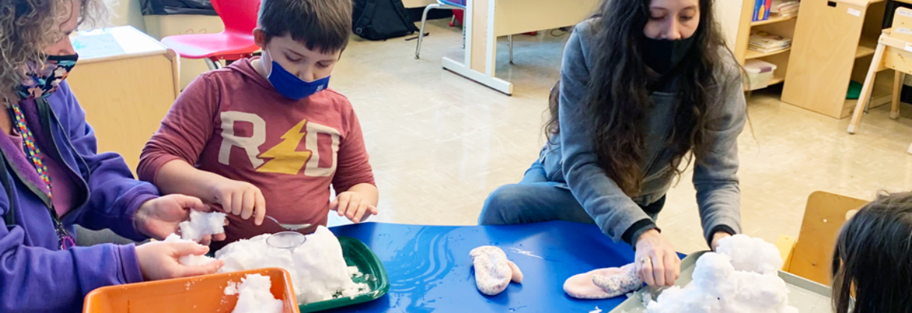


2021-2022
PROPOSED BOCES BUDGET
- As presented to the Dutchess BOCES Board on April 1, 2021

Slide 2
Dutchess BOCES BOARD OF TRUSTEES
Edward L. McCormick
President
Michael Riehl
Vice President
Rick Keller-Coffey
Ralph Chiumento, Jr.
Robert Rubin
Gully Stanford
Thomas Hurley
Nancy Melilli
Clerk of the Board
ADMINISTRATION
Richard M. Hooley, Ed.D., District Superintendent
Cora Stempel, Deputy Superintendent
Norah Merritt, Ph.D., Executive Director for Human Resources
Matthew Metzger, School Business Official

Slide 3

BOCES Financial Structure & Process
  3 Major Budget Categories:
  - Programs & Services
  - Capital & Rentals
  - Administrative, including all BOCES retiree
  health
  No Fund Balance -> Return of Surplus
  BOCES State Aid

Slide 4
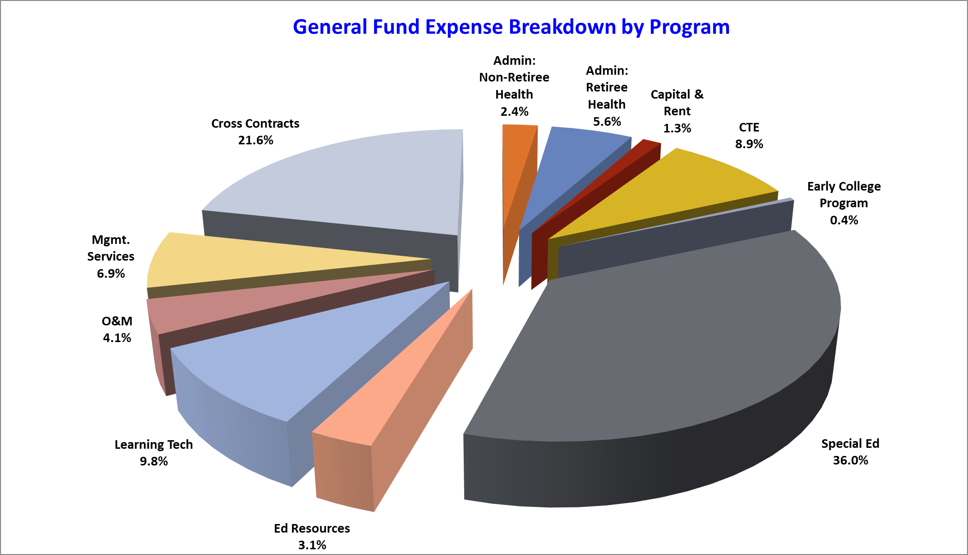

Slide 5
BOCES Challenges
Must continue to offer programs and services that are cutting edge and meet the needs of the districts, while remaining cost effective.
By law, BOCES Retiree Health Insurance Cost must be paid through the Administrative Budget.
Nearly 70% of the Administrative Budget is Retiree Health Insurance costs.

Slide 6
Administrative & Capital Budgets

Slide 7
Administrative & Capital Billings

Slide 8
BOCES Surplus and State Aid
* Districts receive High Cost Aid directly for Special Education Services

Slide 9
2020-2021 Special and Alternative Ed & CTI Students
  351 Special & Alternative Ed Students
  - 101 BETA
  - 130 Salt Point Center
  - 120 In-District
  502 CTI
  - Spread throughout various programs

Slide 10
Responding to Component Requests
  New Programs planned for 2021-2022
  Career Exploration Program at CTI
  Center for Educational Equity and Social Justice
  Center for Sustainability and Climate Education
  E-Rate Category 2 Purchasing
  Expanded Early College Bard

Slide 11
Key Dates
April 27 – Component Boards of Education vote on Administrative Budget and BOCES Board members
May 7 – Final Service Requests due to BOCES

Slide 12
BOCES Board Member Nominees
Marie Johnson (Wappingers)
Richard Keller-Coffey (Webutuck)
Edward L. McCormick (Arlington)
Robert Rubin (Wappingers)
Karen Smythe (Red Hook)
Seats are for 3-year terms. July 1, 2021 through June 30, 2024

Slide 13

Any questions should be emailed to matthew.metzger@dcboces.org

